Slide 1
Involving Voices of Children in Research: practical learnings from MHIPS
Carla Pozo – MHIPS Evaluation Manager

Slide 2
We acknowledge the Traditional Owners of the land on which we learn today and pay our respects to Elders past and present

Slide 3
Overview
Relevance
Example VOC
Key learnings
Recommendations
Drawing to explain ‘help seeking’ (student, 10 years old)

Slide 4
Relevance of VOC

Slide 5
MHIPS Voice of Children
1. THEIR RIGHT
Why involving children in Research/Evaluation?

Slide 6
Why involving children in Research/Evaluation?
2. ENHANCE EFFECTIVENESS

Slide 7
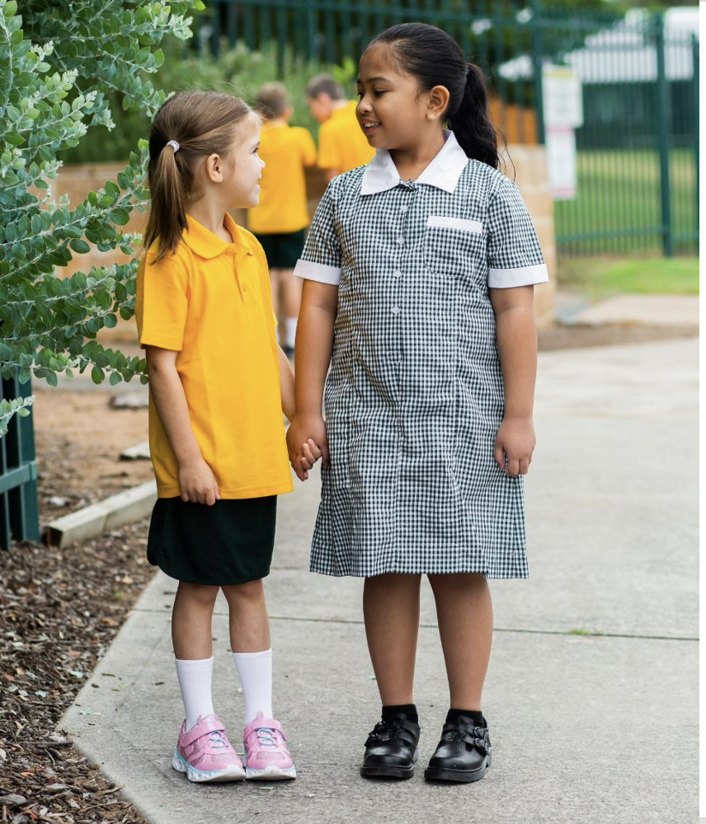
Why involving children in Research/Evaluation?
3. GAP
(Under 12 Yo)
Sun, Y. et al. (2023) – Methods and ethics in Qualitative Research exploring Young Children’s Voice.

Slide 8
Why involving children in Research/Evaluation?
Time – budget
Recruitment - ethics
Why not?
‘children vulnerable’ ‘incapable’
Limited practical Knowledge

Slide 9
How to? MHIPS VOC experience

Slide 10
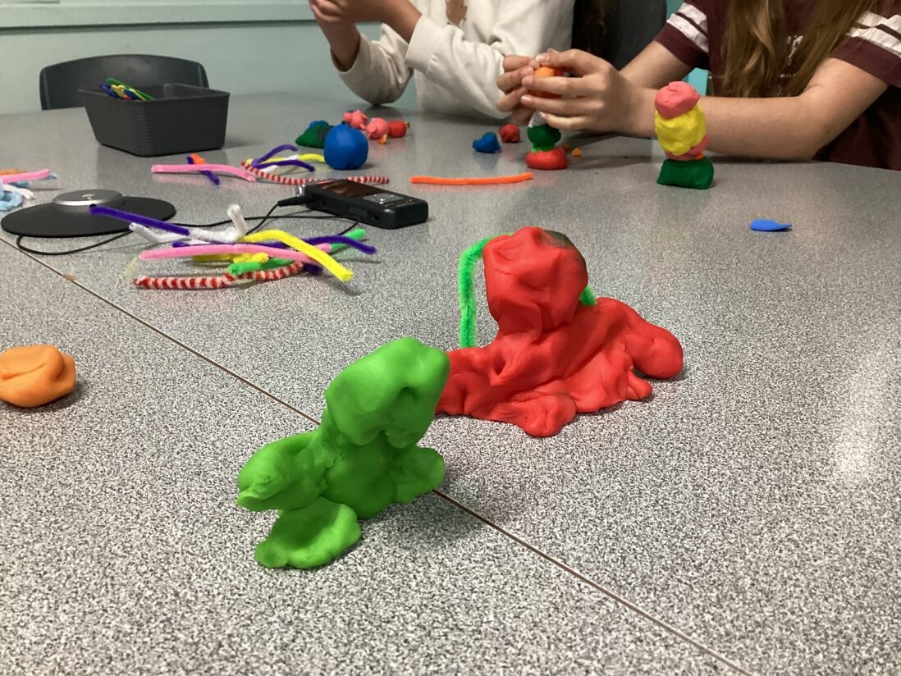
MHIPS Evaluation – Voice of Children
Peer relations
Longitudinal Case studies
14 schools across Victoria
Instruction on emotions
65 students in year 4 and 5
Help seeking
45 min session – 25 min activities

Slide 11
MHIPS VOC – Session
VOC - Year 1: LISTEN
Why we are here?
Warm-up
Voice 1 (Group)
Voice 2
(1 on 1)
Cool –down Acknowledge-ment

Slide 12
Key learnings

Slide 13
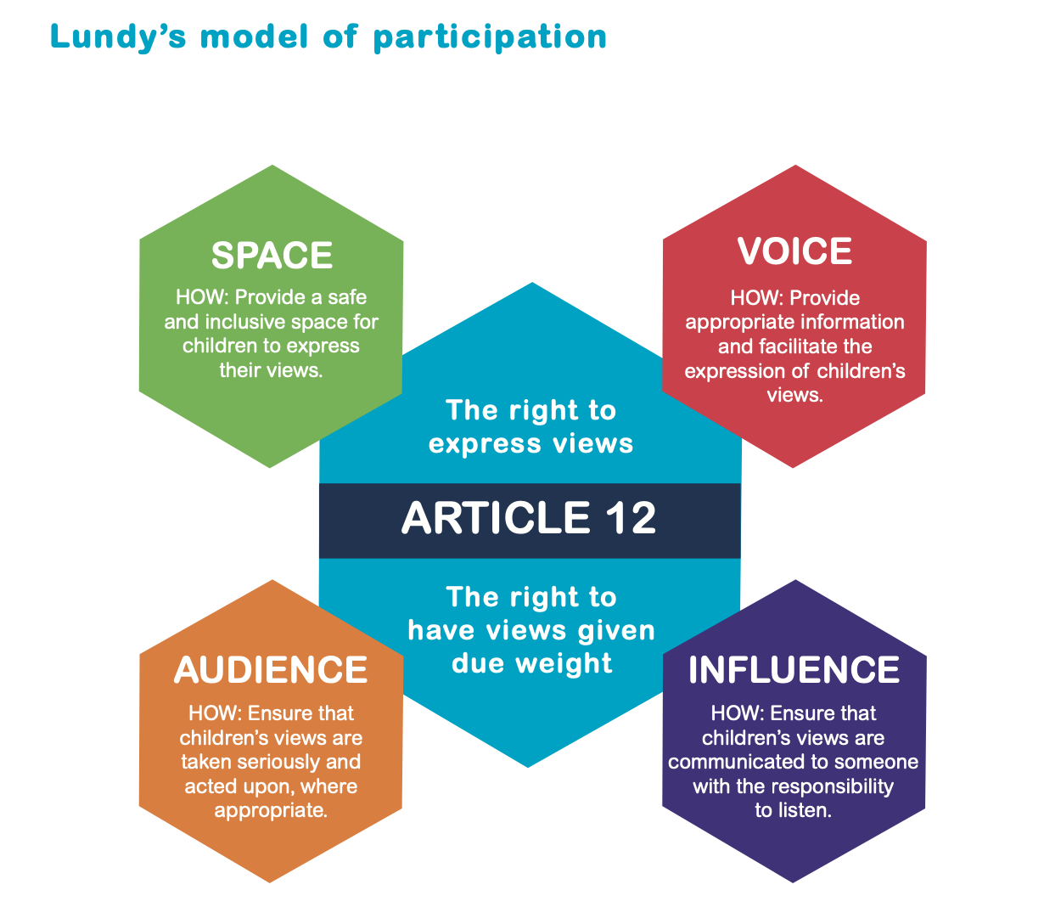
Key learning 1: Methodology
'Voice’ is not enough…
Children must be given the opportunity to express themselves (Space)
Children must be facilitated to express their views (Voice)
Children’s views must be listened to (Audience)
The view must be acted upon, as appropriate (Influence)

Slide 14
Key learning 1: Methodology – Mosaic approach
Mosaic approach, aims for diverse ways to express their views
Criteria: create activities that can work in a classroom where we don’t know anyone.
Mosaic Approach,
Clark (2005)

Slide 15
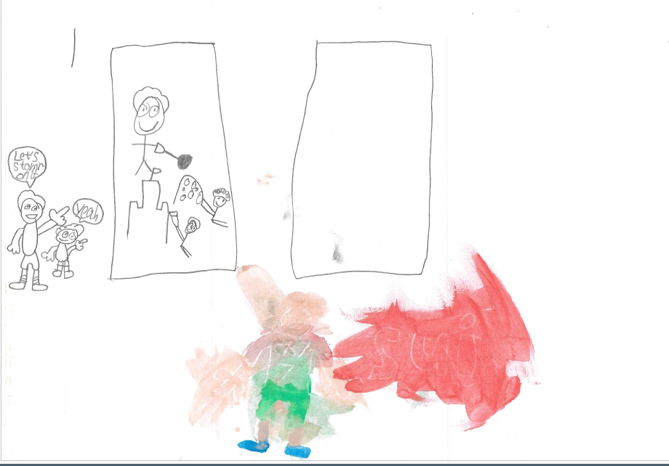
Key learning 1: Methodology – Mosaic approach
Magic Map

Slide 16
Key learning 1: Methodology – Mosaic approach
Rockstars

Slide 17
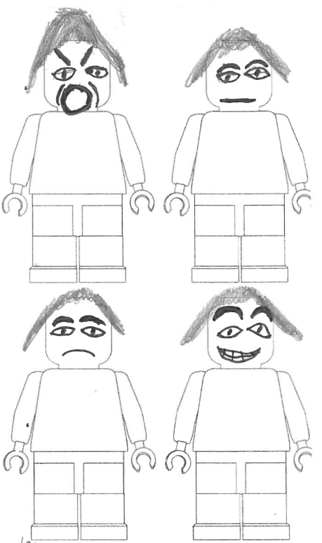
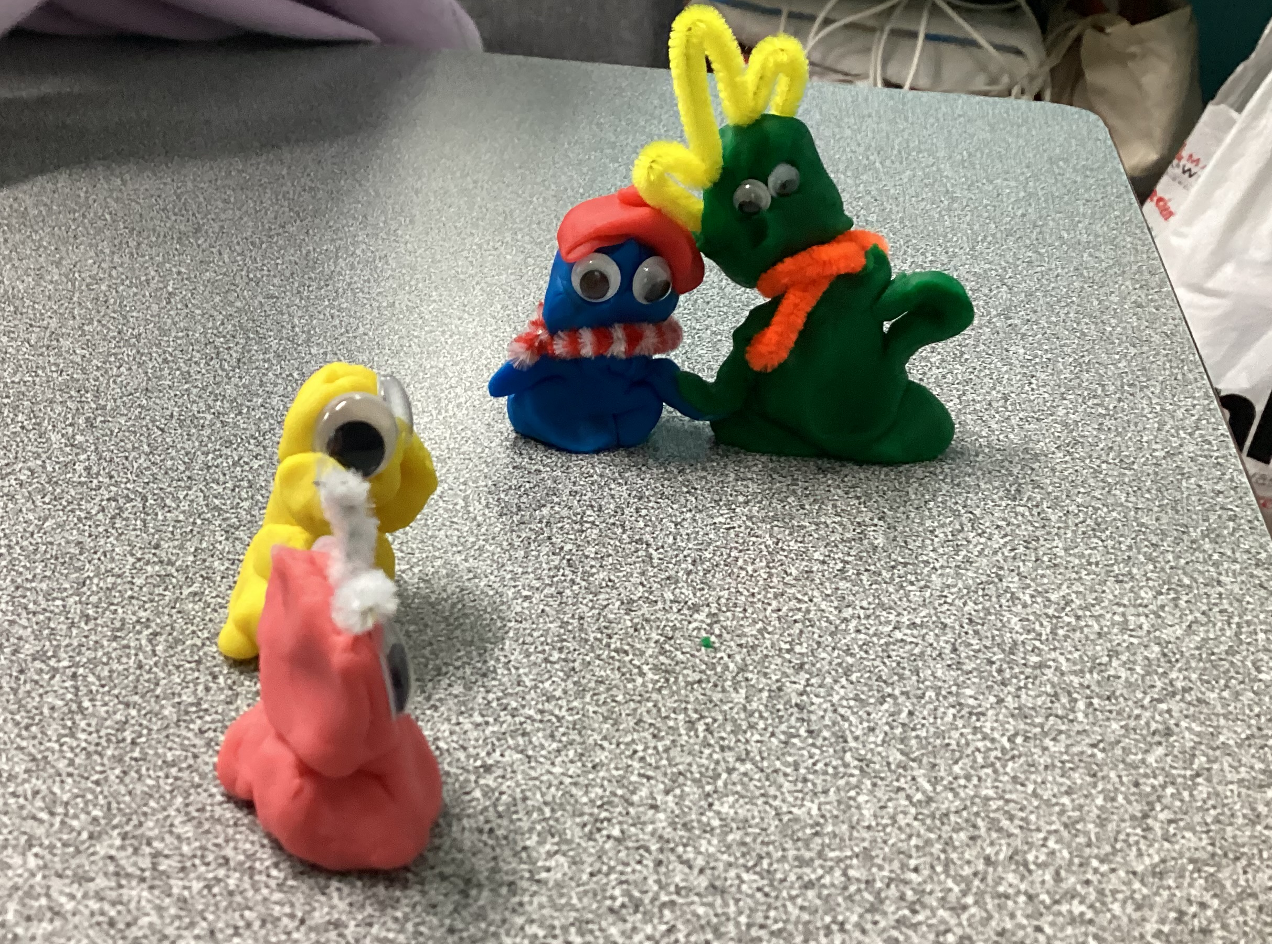
Key learning 1: Methodology – Mosaic approach
Lego People - Playdough

Slide 18
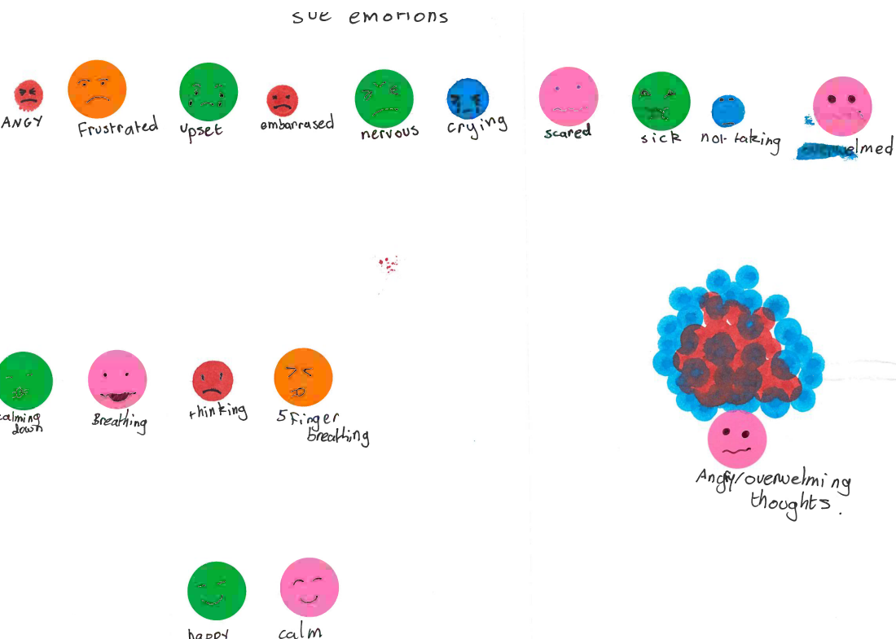
Key learning 1: Methodology – Mosaic approach
Emotions poster

Slide 19
Key learning 2 : aim for higher levels of involvement
Harry Shier (2019) – Analytical tool for develop partnerships
with children and adolescents

Slide 20
Key learning 3 – Consent & Assent
Power dynamics
Relevance of children ‘assenting’ to participate.
Assenting as a key process for respect their voices
Facilitator checking constantly – opportunity to withdraw at any time.
PICF video - Powtoon

Slide 21
Key learning 4: Pedagogy
Involving an expert teacher in our team as a facilitator was key in engagement, activities, flexible approaches.
Great managing group, and power dynamics.
Teachers are hidden researchers!

Slide 22
Recommendations

Slide 23
Final recommendations
1. Value children voices in all stages of research
2. Involve an engaging creative teacher
3. Amplify their voices in child-friendly and relevant ways

Slide 24
If you think that amplifying children voices is meaningful, then make it happen!

Slide 25
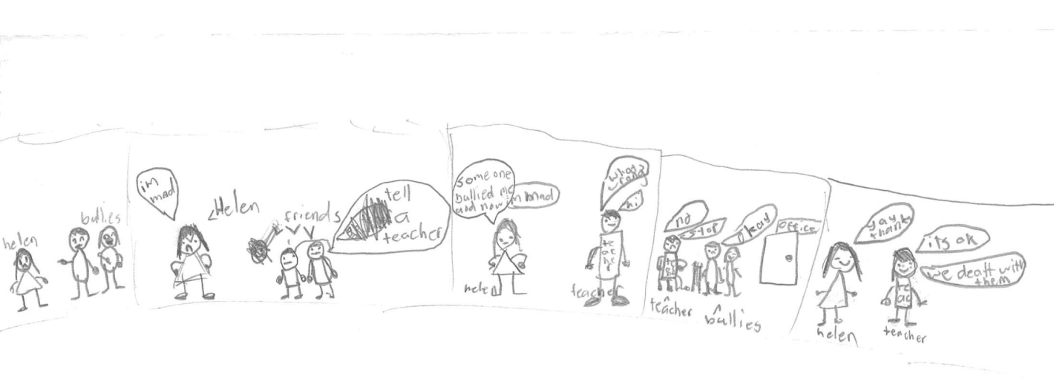
QUESTIONS? carla.pozojeria@mcri.edu.au

Slide 26
Mental Health in Primary Schools, or MHiPS, is a partnership between the Centre for Community Child Health (CCCH) at the Murdoch Children's Research Institute (MCRI), the University of Melbourne Faculty of Education, and the Victorian Department of Education.
MHiPS would like to acknowledge the Ian Potter Foundation and the Helen Macpherson Smith Trust, SALT Catalyst, Bupa, the RE Ross Trust and the R.M. Ansett Trust for their support in establishing the initiative.

